Slide 1





Design of a Mechanism for Securing SECS/GEM Communications from Cyberattacks in the Industry 4.0 Ecosystem
Presented by
Shams Ul Arfeen Laghari
Main Supervisor
Assoc. Prof. Dr. Selvakumar Manickam
Co-Supervisor
Ts. Dr. Shankar Karuppayah
National Advanced IPv6 Centre (NAv6), Universiti Sains Malaysia (USM)
Notes:
In the name of Allah, the most gracious and merciful
Respected Chairman, examiners, supervisor and co-supervisor, and participants, Assalamualaikum and good afternoon.
Today, I am here to present my PhD Thesis Titled Design of a mechanism for Securing SECS/GEM communications in the Industry 4.0 Ecosystem”
SECS is abbreviated as Semiconductor Equipment Communication Standard and
GEM stands for Generic Equipment Model
I am Shams ul Arfeen Laghari, PhD Student at National Advanced IPv6 Centre
My main supervisor is Prof. Dr. Selvakumar, and my Co-Supervisor is Dr. Shankar

Slide 2


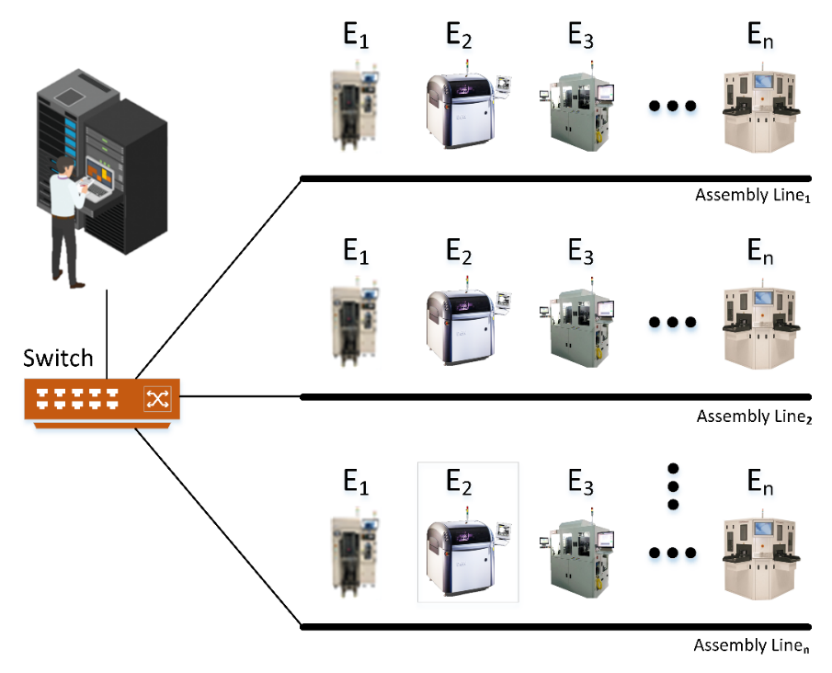
Introduction
Industry 4.0 (I4.0) is the fourth industrial revolution
I4.0 requires interconnecting all production processes
Connecting machines running protocols without security is dangerous
Industrial protocols were designed only for performance; security was not a consideration
Manufacturers are eager to adopt I4.0 so that they can minimize expenses and increase revenue
Compliance to I4.0 is must to retain competitive advantage
Cyberattacks on industrial networks has dramatically increased in recent years
Cyberattacks on manufacturing have jumped from the 8th to the 2nd position, implying a 300% increase in a single year
E = Equipment
Simplified industrial network
Notes:
1. Industry 4.0 (I4.0) is the fourth industrial revolution, and it has completely changed the way products are manufactured, improved and distributed to the consumers.
2. I4.0 requires all production processes digitally interconnected, in order to get near real-time insights into the production systems for effective decision making
3. Protocols designed for industrial networks are operated in a closed, air-gapped environment, so security was not an issue
4. However, when these security-less protocols are used in I4.0 ecosystem, they are vulnerable to cyber-attacks.
5. Manufacturers are eager to adopt I4.0 so that they can minimize expenses and increase revenue
6. Manufacturers forced for compliance with I4.0 otherwise, they may lose their competitive edge,
7. Reports indicate that cyber-attacks on industrial networks are on rise in recent years,
8. Especially, cyber-attacks on manufacturing have jumped from 8th to 2nd position, implying a 300% increase in a single year

Slide 3
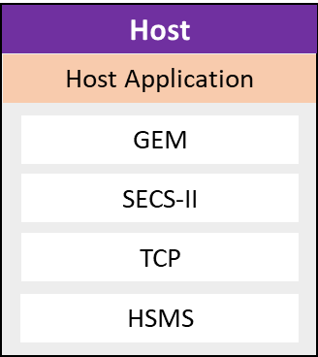
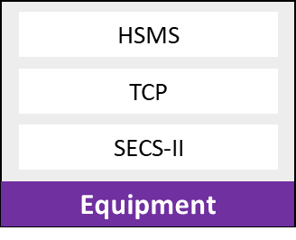

Introduction
Cybercrimes could cost companies $10.5 trillion per year by 2025
Securing Industrial protocols is of utmost priority
Among several M2M Industrial protocols, SECS/GEM is the semiconductor’s equipment-to-host data communications protocol
SECS/GEM is in profound use since its inception
SECS/GEM is a point-to-point protocol, and it is completely devoid of security features
SECS/GEM messages are of two types, control messages, and data messages
SECS/GEM does not require entities to be authenticated
SECS/GEM is vulnerable to several attacks including:
  Denial of Service (DoS) attack
  Replay attack
  False-Data-Injection-Attack (FDIA)
Host
Active
Passive
Notes:
1. It is estimated in different reports that cyber-crimes could cause companies 10.5 trillion per year by the year 2025.
2. Securing Industrial protocols is of utmost priority
3-4. SECS/GEM is an M2M communication protocol, and it is considered as Jugular vein to semiconductor industry and is in profound use since its inception.
5. SECS/GEM was developed for closed and air gapped environments, thus the designers only focused on performance, and completely ignored security features.
6. SECS/GEM messages are of two types, control messages, and data messages. Control messages do not have data part and comprised only HSMS header. Data messages can be of 4.3GB in size.
7. SECS/GEM does not require entities to be authenticated before starting communication, thus, an intruder can easily start and disrupt communication
8. Because there is not security, SECS/GEM is vulnerable to all type of attacks, including DoS, Replay, and FDIA attacks
GEM = Generic Equipment Model
SECS-II = SEMI Equipment Communication Standard 2
HSMS =High-Speed SECS Message Services

Slide 4
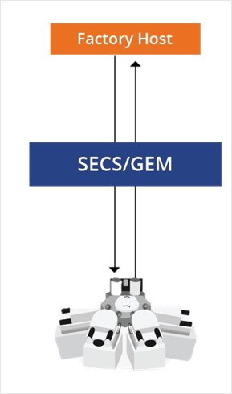


Problem Statement (Simplified)
SECS/GEM lacks an authentication mechanism
SECS/GEM is completely defenseless against cyber-attacks including Denial of Service (DoS) attacks, False-Data-Injection-Attack (FDIA), and Replay Attacks
Notes:
1. Based on the introduction provided in previous introductory slides, it is identified that SECS/GEM lacks an authentication mechanism, which opens up the door for attacker to communicate and inject malicious contents which would either degrade performance, or result in faulty products
2. Since, SECS/GEM does not have any security feature, thus it is vulnerable to attacks including DoS, replay, and FDIA attacks.

Slide 5


Research Objectives
To propose an authentication mechanism
The proposed security mechanism must retain the message structure
To design a rule-based mechanism for preventing cyber-attacks
To build a testbed for evaluating the proposed security mechanism
Notes:
To address issues identified in the problem statement, and make SECS/GEM security-enabled, four Research Objectives are identified in this research.
To prevent unauthorized devices from communicating with the legitimate industry equipment, SECS/GEM is required to be enabled with authentication mechanism
There are several applications designed for analytics, thus, it is required that the proposed mechanism must not modify existing message structure
To prevent cyber-attacks, a rule-based mechanism is required which will enable SECS/GEM to classify messages into legitimate and illegitimate and prevent attacks
The fourth objective is to build a testbed in order to evaluate the performance of the proposed security mechanism

Slide 6
Limitations and Research Scope
Limitations
This research focuses only on authentication and defense against cyberattacks
DoS attack by flooding the victim is beyond the scope this research
DoS and other attacks are conducted on HSMS protocol
Performance evaluation is conducted using emulators in a testbed environment
Secret Keys are preconfigured on machines during configuration
Item | Scope of Research
Environment | TCP/IP Network
Security Mode | Authentication
Attack Types | DoS, Replay Attack, False-Data-Injection-Attack (FDIA)
OSI Target Layer | Application Layer, Transport Layer
Evaluation Metrics | Processing Time, Protocol Control Overhead, Attack Prevention Success Rate
Notes:
Limitations
------------
1. Although, our proposed security mechanism is versatile, and highly configurable, however, in this research the focus is on authentication and prevention of cyber-attacks.
2-3. The DoS attack is usually carried out by flooding the victim with overwhelming traffic which it cannot process, however, this type of DoS attack is beyond the scope of this research, instead, attacks are carried on SECS/GEM’s transport protocol named as HSMS or Highspeed SECS messaging service
4. Instead of running proposed mechanism on real industry equipment, a testbed is developed for the performance evaluation
5. For authentication using HMAC algorithms, a secret key is needed. These keys are preconfigured on machines, and no key distribution mechanism is employed.
Scope of Research
--------------------
The table specifies the scope of the research, the proposed mechanism is evaluated in terms of processing time, control overhead and defense against cyber-attacks

Slide 7


Related Work
There is extensive literature available for securing protocols operating in the industrial ecosystem
Authentication is achieved by utilizing PKI (Public-key-infrastructure) based mechanisms
There exists not a single study that provides solutions to secure SECS/GEM communications
As part of the industrial research project, we provided two solutions (i.e., SECS/GEMsec and Secured SECS/GEM)
PKI-based systems are complex and have a high processing time
PKI-based solutions are effective where there are several clients connecting to a server
Connection request
Connection Ack
Request Data/Control Message
Response Data/Control Message
SECS/GEM Communication
Notes:
1. There is extensive research work going on for securing protocols operating in the industrial ecosystem
2. The literature available suggests that the authentication is a fundamental security prerequisites which is usually achieved by employing PKI-based systems.
3. To best of our knowledge, there is no mechanism to authenticate or secure SECS/GEM protocol
4. As part of our industrial research project, we were asked to enable security in SECS/GEM, the project was split into two parts (1) to enable authentication and prevent attacks, and (2) to enable confidentially with authentication.
Based on the available literature, we were inspired by PKI-based solutions so we developed an authentication mechanism named as SECS/GEMsec
And we also proposed another mechanism for achieving confidentiality which we named as Secured SECS/GEM
5-6. We identified that the mechanisms we proposed were complex and required high processing time, also we noticed that the PKI based solutions were suitable for systems where several clients were connecting with a centralized server.
As we know that SECS/GEM is a point-to-point communication protocol, thus PKI based solutions were not needed.
We realized that there is a need for a comprehensive mechanism which not only offers authentication and prevents cyber-attack, but also optionally offers confidentiality. We decided not to use PKI based solutions because they are complex and require high processing time

Slide 8
Related Work (Cont.)
Mechanism | Security features and Strengths | Limitations
Standard SECS/GEM (SEMI, 1994) | N/A | No authentication No protection against cyber-attacks at all No mechanism to ensure message integrity No support for confidentiality
SECS/GEMsec Shams A. Laghari, et al., 2021) | Offers authentication Ascertains message integrity Detection and prevention of cyber-attacks, including DoS attacks, Replay Attacks, and FDIA attacks | Very high processing time High control overhead (i.e., it appends control data with each message exchanged) It is a digital signature-based solution; thus, it requires multiple keys The mechanism is hardcoded and does not offer to choose algorithms for hashing and digital signature Fixed algorithm, as well as key sizes (RSA=2048, SHA2-256), cannot be changed
Secured SECS/GEM Ashish Jaisan, et al., 2021) | Offers confidentiality Authenticates only data messages | Only encrypts payloads, thus cannot protect the privacy Vulnerable to replay attacks It does not authenticate control messages Vulnerable to DoS attack
Notes:
The details of our previously proposed two security mechanisms are listed in this table along with their strengths and shortcomings
The standard SECS/GEM is also mentioned here in this table because it is used a benchmark for the features required

Slide 9
Research Gap
Existing mechanisms are hard-coded
No provisioning for different security features
Existing mechanisms are complex
Existing mechanisms are vulnerable to attacks
Attribute | Mechanism
 | Standard SECS/GEM | Secured SECS/GEM | SECS/GEMsec
Multi-featured | ✗ | ✗ | ✗
Customizable | ✗ | ✗ | ✗
Authentication | ✗ | ✓* | ✓
Confidentiality | ✗ | ✓* | ✗
Integrity | ✗ | ✓* | ✓
Lightweight | – | ✓ | ✗
DoS Attack Resilient | ✗ | ✗ | ✓
Replay Attack Resilient | ✗ | ✗ | ✓
FDIA Attack Resilient | ✗ | ✗ | ✓
Notes:
The available mechanisms for securing SECS/GEM communication are mentioned in this table along with available features.
1. The existing mechanisms are hard-coded and do not allow customization, for example, change of algorithm or change of key size
2. No provisioning for different security features, i.e., there is no way that both confidentiality and authentication can be achieved at once
3-4. Existing mechanisms are either complex or vulnerable to cyber attacks
Based on the observations, we propose a mechanism which is lightweight, multi-featured, customizable, and prevents cyber-attacks.

Slide 10
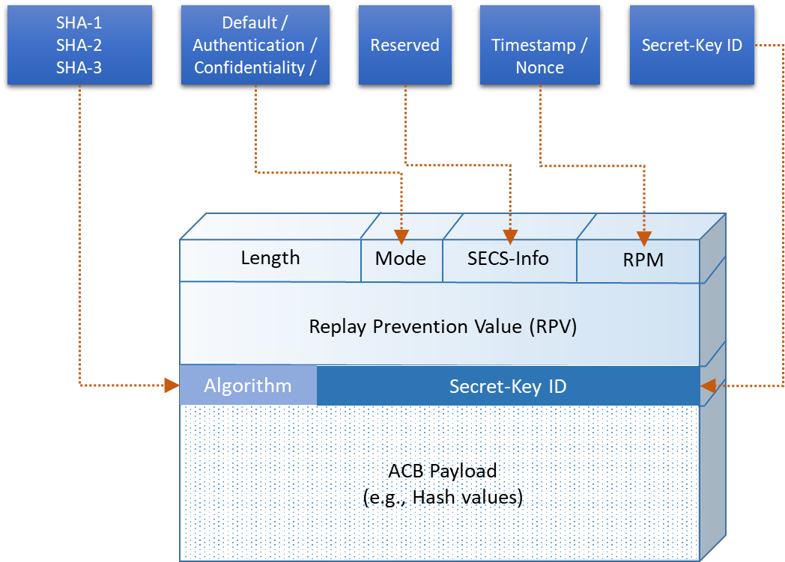
Proposed Mechanism: Architecture
SECS/GEM Security Mechanism (SGSM)
Length: Determines ACB length
Mode: Specifies operational mode (i.e., Mode=1 [authentication])
SECS-Info: Reserved for future usage
RPM: Identifies mode to be used for detecting replay attacks
RPV: Used to store value to indicate the freshness of the message
Algorithm: Determines algorithm to compute the hash
Secret-Key ID: Identifies several keys on an active entity
ACB Payload: Carries hash value or other control information
Authentication Code Block (ACB)
ACB | Authentication Code Block
RPM | Replay Prevention Mode
RPV | Replay Prevention Value
Notes:
We named our proposed mechanism as SECS/GEM Security Mechanism or SGSM in short.
The message structure of SGSM is shown on the figure
The details of each field is provided.
Length: Determines ACB length
Mode: Specifies operational mode (i.e., Mode=1 [authentication])
SECS-Info: Reserved for future usage
RPM: Identifies mode to be used for detecting replay attacks
RPV: Used to store value to indicate the freshness of the message
Algorithm: Determines algorithm to compute the hash
Secret-Key ID: Identifies several keys on an active entity
ACB Payload: Carries hash value or other control information

Slide 11
SGSM – Architecture
At Sender
ACB Generation & Initialization
Information such as RPM, Secret Key ID, mode, and algorithm required to generate ACB
Based on the key size, generate the ACB for authentication
Attach ACB to HSMS message
Authentication & Integrity
Select the HMAC algorithm (SHA1, SHA2, SHA3, etc.)
Fetch the key to hash messages (applies to an active entity only)
Timestamp generation (i.e., RPV)
Based on mode and algorithm, generate hash
Stage One
ACB Generation and Initialization
RPM
Secret Key ID
Mode
Algorithm
Objective-II
ACB Generation and Initialization
SECS/GEM Message
ACB
ACB
Stage Two
Achieving Authentication & Message Integrity
HMAC
SECS/GEM Message
ACB
Length
MD
S-Info
RPM
Objective-I
Key-Lookup
RPV
Algo
Secret Key-ID
TS-Lookup
ACB Payload
Message Integrity Check
Stage Three
Attack Prevention
At Receiver
Rule-based Mechanism
Objective-III
Attack Prevention
Analyze received messages and discard illegitimate messages
Detect and mitigate attacks
Legitimate Messages
Illegitimate Messages
DoS Attack
FDIA Attack
Replay Attack
Notes:
The architecture of the proposed mechanism is split into four main sections where each section addresses a research objective of this study.
1. The research objective 2 states that the message structure of existing SECS/GEM mechanism must not be altered, therefore we attach a control block with each message. The control block is named as authentication code block or ACB in short. The sender is required to Generate the ACB and initialize it with all zeros. Once ACB is generated, it is attached at the end of the message.
2. Once, ACB is attached, the ACB fields are assigned values which are available in a configuration file. Based on the values stored in ACB, the hash is generated for authentication, which satisfies our second research objective
3. The messages are either accepted or rejected based on the rules defined. Thus, this satisfies our 3rd research objective.
4. The fourth research is to develop a testbed which is explained in subsequent slides.

Slide 12
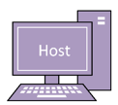

SGSM – Workflow
Receive HSMS message
Process HSMS Message
Is receiver
active entity?
No
First message?
No
Generate ACB
[Initialize it with all zeros]
Yes
ACB Present?
Yes
Yes
Set Mode = 1 [Authentication]
Fetch secret-key
from the table
No
No
TS₁ > TS₂?
SET HMAC Algorithm
Discard Message
Compute Hash
Hash = H (msg+ACB), Key)
Is sender
active entity?
No
Yes
SET Timestamp = Value
Hash₁ = Extract Hash
TS₂ = new TS₁ value
Yes
Yes
Hash₁ == Hash₂?
Fetch secret-key
from the table
No
Discard Message
Compute Hash
Hash = H (msg+ACB), Key)
Discard Message
Transmit the message
Refill ACB with Zeros
Process RPV
Accept Message

Slide 13
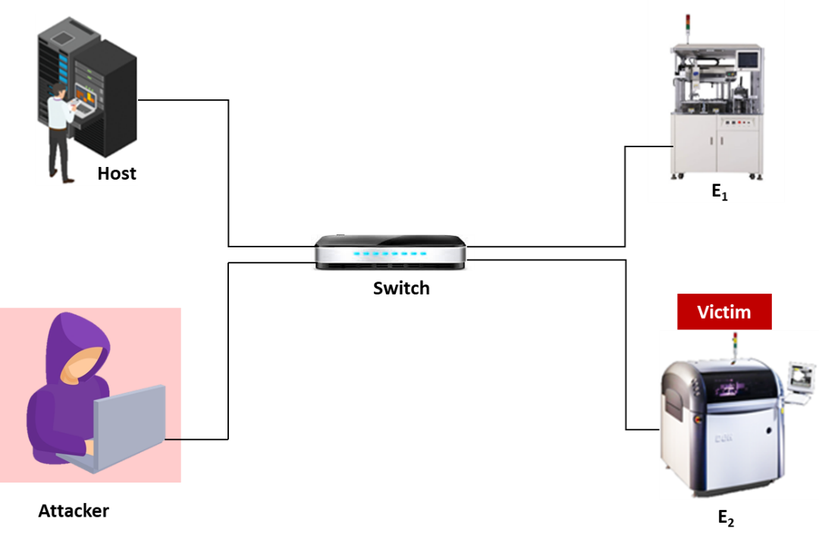
Experimental Setup: Testbed
Stage Four
Testbed Design and Performance Evaluation
Normal Scenarios
Attack Scenarios
Objective-IV
Processing
Time
Control
Overhead
DoS
Replay
FDIA
Testbed
Notes:
There are two separate scenarios to evaluate the performance of the proposed mechanism (1) normal scenario and (2) attack scenario
The figure shows attack scenario, the normal scenario does not have attacker in the network.
The development of the testbed satisfies our fourth research objective.

Slide 14
Experimental Setup: Evaluation Strategies
Evaluation Strategy
Normal Scenario
Attack Scenario
Processing Time
Control Overhead
DoS Attack
Prevention Success Rate
1. SHA-1
2. SHA256
3. SHA512
4. SHA3-256
5. SHA3-512
SGSM (HMAC variants)
SGSM (HMAC variants)
FDIA Attack
Prevention Success Rate
Secured SECS/GEM
Other Mechanisms
1. Standard SECS/GEM
2. SECS/GEMsec
3. Secured SECS/GEM
Replay Attack
Prevention Success Rate
SECS/GEMsec
Total Processing
Overhead
Notes:
Normal Scenario
1. Processing Time SHA1, SHA256, SHA512, SHA3-256, SHA3-512
2. Processing Time (Standard SECS/GEM vs. SECS/GEMsec vs. Secured SECS/GEM)
3. Total Processing Time (Graph explaining)
Attack Scenario
DoS Attack
FDIA Attack
Replay Attack

Slide 15

Results: Processing Time
Processing Time (at the sender)
Processing Time (at the receiver)
Notes:
The performance of the proposed mechanism is evaluated in terms of processing time. The processing time is measured at both sender and receiver.
As our proposed mechanism is versatile and supports selecting several HMAC algorithm, the processing time of different HMAC algorithms are shown in the graph.
The X-Axis shows the number of times experiments repeated, and Y-Axis shows time in milliseconds.
1. It can be observed that the performance at sender with all HMAC variants is lower than 0.7 milliseconds
2. The performance is even better at receiver (i.e., 0.3 m/s) because the receiver is only extracting Hash value and performing some checks.

Slide 16
Results: Processing Time (cont.)
Processing Time: Standard vs. SGSM vs. Secured SECS/GEM vs. SECS/GEMsec
Notes:
As Secured SECS/GEM is using AES with 256-bit key size, we have also used same key size to compare performance with other mechanisms.
The processing time of SGSM is better than both SECS/GEMsec and Secured SECS/GEM. SHA256 has a little higher processing time than the standard SECS/GEM, which is considered impressive.
The SECS/GEMsec is worst performer, it exhibited highest processing time. The reason for having highest processing time is because it is digital signature-based mechanism.
2. Processing time at receiver is shown in another graph, SGSM has yet again proved that it is superior to other mechanisms in terms of processing time.

Slide 17
Results: Processing Time (cont.)
Total Processing Time: SGSM(SHA256) vs. Secured SECS/GEM vs. SECS/GEMsec
Notes:
This graph shows that for both sending and receiving messages, our proposed SGSM mechanism outperformed both mechanisms in terms of processing time.
The SGSM exhibited promising results, as compared with the Secured SECS/GEM mechanism, our proposed SGSM reduced processing time by 18% and 38% for sending and receiving messages, respectively. Similarly, Compared to the SECS/GEMsec, the SGSM reduced processing time by 97% and 99% for sending and receiving messages, respectively.

Slide 18
Results: Control Overhead
Control overhead (SGSM) with growing message size
SGSM(SHA256) Control overhead
Message Type | HSMS (header) | Payload (bytes) | SGSM Overhead | Total Size | Control Overhead
Control Message | 14 | 0 | 48 | 62 | 77.419%
Data Message (1KB) | 14 | 1024 | 48 | 1086 | 4.420%
Data Message (1MB) | 14 | 1048576 | 48 | 1048638 | 0.005%
Data Message (10MB) | 14 | 10485760 | 48 | 10485822 | 0.000%
SGSM Overhead = ACB Header + Hash size
= 16 + 32
= 48
Comparison of Control Overhead
Protocol | Control Message (10 bytes) |  | Data Message (100 bytes)
 | Actual | Overhead | Actual | Overhead
Standard SECS/GEM | 14 | 0 | 114 | 0
SECS/GEMsec | 14 | 512 | 612 | 512
Secured SECS/GEM | 14 | 0 | 132 | 32
SGSM | 14 | 48 | 148 | 48
Notes:
1. The performance of the proposed mechanism is also measured in terms of Control Overhead. The extra bytes attached with each message is considered as control overhead. As SGSM attaches ACB with each message, the impact of extra bytes is shown in this table.
2. It is important to observe that as message size increases, the significance of control overhead decreases. With a message of 1000 bytes, the impact of control overhead is almost negligible.
3. The Control overhead of SECS/GEMsec and Secured SECS/GEM is shown in the final table.
It can be seen that the control overhead of SECS/GEMsec is higher with same level of security, because it uses 4096-bit key size which provides same results as 256-bit with HMAC algorithms

Slide 19
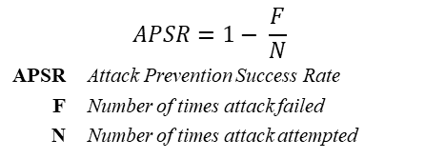
Results: Security Analysis
Summarized results of Cyber-attacks
Standard
SECS/GEMsec
Secured
SGSM
SECS/GEM
SECS/GEM
Attack Type
N
F
APSR
N
F
APSR
N
F
APSR
N
F
APSR
DoS
20
20
0
20
0
1
20
20
0
20
0
1
Replay
20
20
0
20
0
1
20
20
0
20
0
1
FDIA
20
20
0
20
0
1
20
20
0
20
0
1
$$APSR=1− \frac{F}{N}$$ | $$APSR=1− \frac{F}{N}$$
APSR | Attack Prevention Success Rate
F | Number of times attack failed
N | Number of times attack attempted
Notes:
The final parameter on which performance is measured is Prevention against cyber-attacks.
The experiments were repeated 20 times for each attacks and performance was measured. APSR refers to Attack Prevention Success Rate, N refers to Number of times attacks attempted, F refers to Number of times attacks failed.
1. Under DoS attack, It can be seen that SGSM and SECS/GEMsec successfully detected and mitigated attacks, however, SECS/GEMsec has higher processing time thus its applications are limited
2-3. The performance with Replay and FDIA attacks is same, and SGSM successfully detected and mitigated attacks carried on SECS/GEM communications.
Although, SECS/GEMsec also prevented attacks, however its processing time is very high, which makes it applications limited at commercial level.
Secured SECS/GEM Failed to prevent attacks, because it only encrypts data messages, whereas most of the attacks are carried out using control messages
Here, we can safely say that the proposed SGSM mechanism outperformed other mechanisms in all aspects and is suitable for commercial use.

Slide 20
Results: Summary
SGSM secures SECS/GEM communications
SGSM is multi-featured and versatile mechanism
SGSM attains customizability
SGSM offers authentication and attains integrity
SGSM is Lightweight
SGSM detects and mitigates DoS attacks
SGSM detects and mitigates FDIA attacks
SGSM detects and mitigates Replay attacks
Attribute | Mechanism
 | Standard SECS/GEM | Secured SECS/GEM | SECS/GEMsec | SGSM
Multi-featured | ✗ | ✗ | ✗ | ✓
Customizable | ✗ | ✗ | ✗ | ✓
Authentication | ✗ | ✓* | ✓ | ✓
Confidentiality | ✗ | ✓* | ✗ | ✓**
Integrity | ✗ | ✓* | ✓ | ✓
Lightweight | – | ✓ | ✗ | ✓
DoS Attack Resilient | ✗ | ✗ | ✓ | ✓
Replay Attack Resilient | ✗ | ✗ | ✓ | ✓
FDIA Attack Resilient | ✗ | ✗ | ✓ | ✓
* represents data messages only
** Can support confidentiality)
Notes:
The Table summarizes the features supported by different mechanisms. It can be seen that SGSM stands strong on all accounts and outperforms other mechanisms with margin.
SGSM secures SECS/GEM communications
SGSM is multi-featured and versatile mechanism
SGSM attains customizability
SGSM offers authentication and attains integrity
SGSM is Lightweight
SGSM detects and mitigates DoS attacks
SGSM detects and mitigates FDIA attacks
SGSM detects and mitigates Replay attacks

Slide 21

Research Contribution
Proof of Concept that SECS/GEM protocol is vulnerable to cyber-attacks
Testbed design for performance evaluation
SGSM is among the first attempts to secure SECS/GEM communications
SGSM is highly configurable and allows adaptations to the desired security level
SGSM attains authentication and integrity
SGSM detects and mitigates DoS, Replay, and FDIA attacks
Notes:
Finally, I would like to highlight our main contribution
Proof of Concept that SECS/GEM protocol is vulnerable to cyber-attacks
Testbed design for performance evaluation
SGSM is among the first attempts to secure SECS/GEM communications
SGSM is highly configurable and allows adaptations to the desired security level
SGSM attains authentication and integrity
SGSM detects and mitigates DoS, Replay, and FDIA attacks

Slide 22
Publications
Shams A. Laghari, Selvakumar Manickam, Ayman Al-Ani, Shafiq Ul Rehman, & Shankar Karuppayah (2021). SECS/GEMsec: A Mechanism for Detection and Prevention of Cyber-Attacks on SECS/GEM Communications in Industry 4.0 Landscape. IEEE Access, 9, 154380-154394.
Shams A. Laghari, Selvakumar Manickam, Shankar Karuppayah, Ayman Al-Ani, and Shafiq Ul Rehman, "Cyberattacks and Vociferous Implications on SECS/GEM Communications in Industry 4.0 Ecosystem" International Journal of Advanced Computer Science and Applications(IJACSA), 12(7), 2021.
Shams A. Laghari, Manickam, S., & Karuppayah, S. (2021). A review on SECS/GEM: A machine-to-machine (M2M) communication protocol for industry 4.0. International Journal of Electrical and Electronic Engineering & Telecommunications, 10(2), 105-114.
Shams A. Laghari, Manickam, S., & Karuppayah, S. SGSM enabled cyber-attack detection and mitigation mechanism for securing SECS/GEM communications in Industry 4.0 Ecosystem, IEEE Access (Ready to be submitted)
Shams A. Laghari, Manickam, S., & Karuppayah, S. (Submitted). SGSM: A mechanism for securing SECS/GEM communications in industry 4.0 Ecosystem, IEEE Access (Ready to be submitted)

Slide 23

Thank You

Slide 24
Introduction (cont.)
HSMS Message Structure
Length: Determines HSMS message length
Session ID: Used by subsystems to identify session details
Stream: Determines specific stream (message category) number
Function: Identifies a specific function within a given stream
PType: Presentation type, always zero for SECS-II messages
SType: Determines message type (e.g., control ➔ SType=!0, data ➔ SType=0)
System Bytes: Uniquely identifies and maps request and response messages
Control messages
(Header only)
Message Header (10 bytes)
Session
ID
W
Function
Length
Stream
PType
SType
System Bytes
Data
(optional)
Data Message

Slide 25
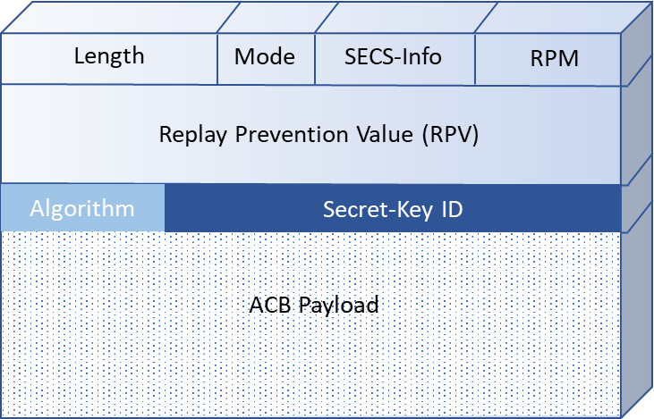
SGSM integration with SECS/GEM
Session
ID
W
Function
ACB
(Authentication Code Block)
Data Messages
Length
Stream
PType
SType
System Bytes
Message
Data
Session
ID
W
Function
ACB
(Authentication Code Block)
Control Messages
Length
Stream
PType
SType
System Bytes
Notes:
How much is the minimum and maximum payload size of ACB with different algorithms?

Slide 26
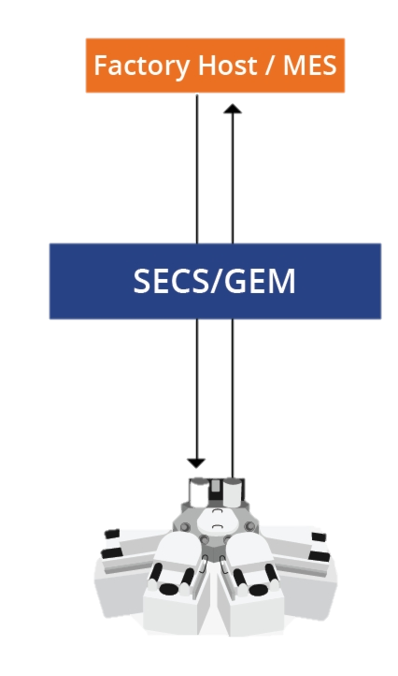


Problem Statement
The SECS/GEM specifications, by default, do not require communicating entities to be authenticated before exchanging messages. Thus, any malicious node can act as a legitimate host/equipment and establish a communication link with other devices in the network, resulting in denying access to the legitimate factory equipment in the industrial communication network
The SECS/GEM specifications do not offer any safeguards to protect against cyber-attacks; thus, there exists no mechanism that protects messages from being altered while in transit. The absence of security features enables adversaries to launch various attacks such as False-Data-Injection-Attack (FDIA), time-delay attacks, data tampering attacks, replay attacks, and spoofing attacks
Notes:
Attack Types
------------------
1. FDIA: A false injection attack is a deception attack, in which the adversary injects false information into the network; for example, by sending malicious commands on a field bus.
2. Time-Delay: An attacker injects extra time delays into measurements and control values of the systems which can disturb the stability of the system and cause equipment to crash.
3. Spoofing attack: Spoofing attacks are where an attacker's node impersonates a system entity. A lack of adequate authentication control mechanisms means that entities can masquerade as one another by falsifying their identity to gain illegitimate access.
4. Replay attack: In a replay attack, legitimate packets can be re-transmitted by an adversary. This can happen in several ways: an authentic but compromised node could send the data, e.g. an adversary who managed to intercept an authentication message.
5. Data tampering attack: Data tampering attacks cause unauthorized alteration of data, which could be in storage or in transit. For example, the data held in data historians’ and engineers’ work- stations could be altered, or the network data packets could be changed causing, significant damage to the operation of the plant.

Slide 27

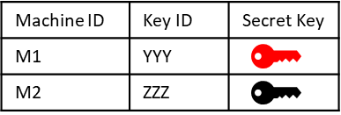
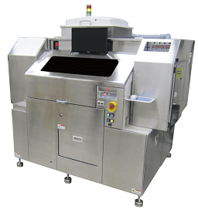
Basic Terminology
HOST
M1
M2
SECS/GEM
Configurations
Remote IP: 10.0.0.2
Remote Port: 5000
IP: 10.0.0.2
Port: 5000
IP: 10.0.0.3
Port: 5000
Mode: Active
Mode: Passive
Mode: Passive
ACB
ACB
ACB
Mode : [1] Authentication
Algorithm : [1] HMAC: SHA-1
PRM : [1] Timestamp
Mode : [1] Authentication
Algorithm : [1] HMAC: SHA-1
PRM : [1] Timestamp
KEY :
Mode : [1] Authentication
Algorithm : [1] HMAC: SHA-1
PRM : [1] Timestamp
KEY :
SGSM
Configurations

Slide 28
Introduction (cont.)
SECS/GEM Fundamentals
Equipment: An intelligent factory machine that is used to manufacture products
Passive Mode: Entity that opens a TCP port and listens for incoming connections
HOST: An intelligent system that communicates with the industry equipment
Active Mode: Entity that initiates the connection request
GEM: It defines a software interface that runs on manufacturing equipment
SECS-II: defines the format and content of messages that can be sent over HSMS
HSMS: a transport protocol for SECS/GEM communications (replacing SECS-I)
Host
Active
Passive
Notes:
SECS = Semiconductor Equipment Communication Standard
GEM = Generic Equipment Model
HSMS = High-Speed SECS Message Services
TCP = Transmission Control Protocol

Slide 29
Results: Processing Time
Processing Time (at the sender)
Processing Time (at the receiver)

Slide 30
Results: Processing Time (cont.)
Processing time (at the receiver): Standard vs. SGSM vs. Secured SECS/GEM vs. SECS/GEMsec

Slide 31
SGSM – Workflow
Receive HSMS message
Process HSMS Message
Is receiver
active entity?
No
First message?
No
Generate ACB
[Initialize it with all zeros]
Yes
ACB Present?
Yes
Yes
Set Mode = 1 [Authentication]
Fetch secret-key
from the table
No
No
TS₁ > TS₂?
SET HMAC Algorithm
Discard Message
Compute Hash
Hash = H (msg+ACB), Key)
Is sender
active entity?
No
Yes
SET Timestamp = Value
Hash₁ = Extract Hash
TS₂ = new TS₁ value
Yes
Yes
Hash₁ == Hash₂?
Fetch secret-key
from the table
No
Discard Message
Compute Hash
Hash = H (msg+ACB), Key)
Discard Message
Transmit the message
Refill ACB with Zeros
Process RPV
Accept Message

